Slide 1
Stage 3 Update
CPSC 481 T01 Group B
TA: Hessam Djavaherpour
Dheeraj Kumar • Gabriella Kenna • Jason Li • Paru Basnet • Zahra Ghavasieh

Slide 2
Project Idea
The idea behind our project is a mobile application that would make it easier on plant owners to keep track of their plants' health as well as to make it easier for people to get into owning plants at home. In order to achieve this, the application would provide users with:
Information about plants to encourage growth (soil type, ideal temperature, etc.)
Reminders for when the plants should be attended to.
Provide a one-stop-shop for information, advice, and assistance for owning plants
Notes:
Jason
The idea behind our project is a mobile application that would make it easier on plant owners to keep track of their plants' health as well as to make it easier for people to get into owning plants at home. In order to achieve this, the application would provide users with:
Information about how to take care of plants, such as the plant’s preferred soil type and ideal temperature, what the soil should be like when its ready to be watered, and more
Reminders for when the plants should be attended to.
Provide a one-stop-shop for information, advice, and assistance for owning plants

Slide 3
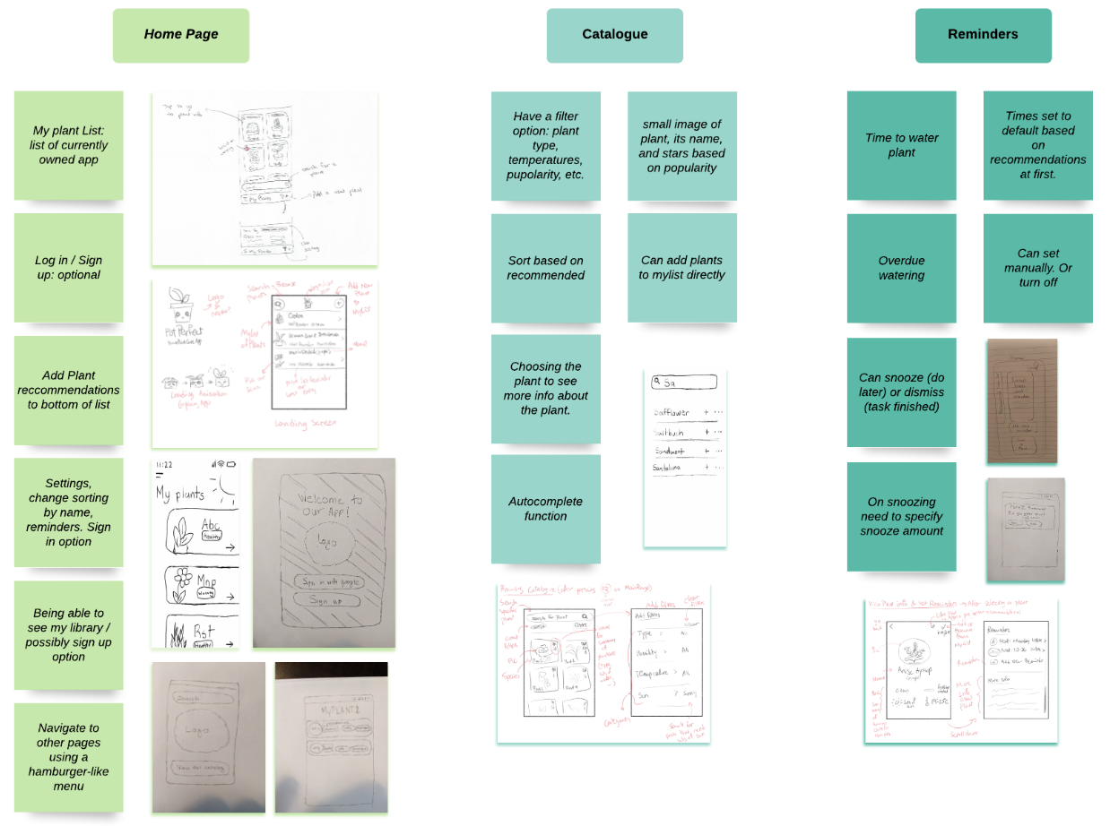
Affinity Diagram
Notes:
Jason

Slide 4
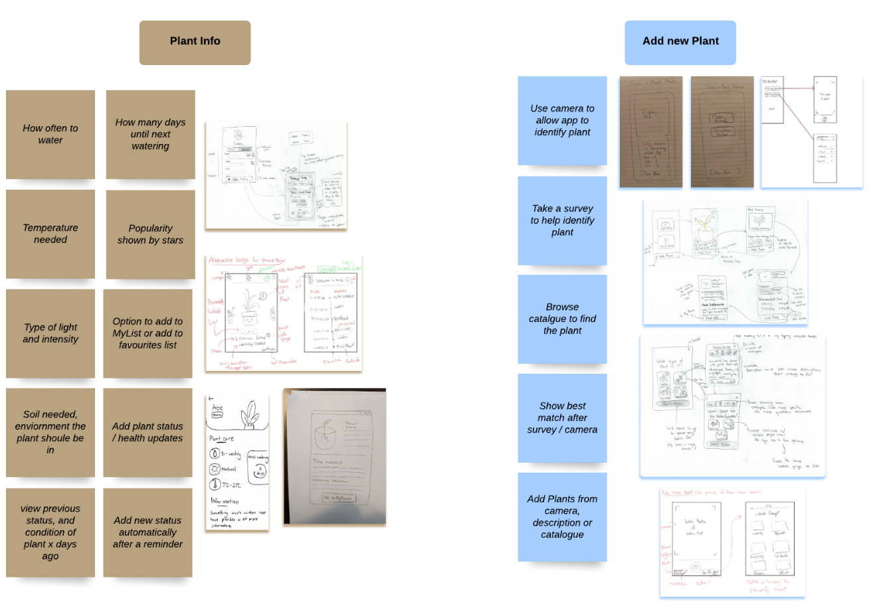
Affinity Diagram
Notes:
Jason

Slide 5
Prototype Demo

Slide 6

Discarded Ideas (paru)
Favorite Plants Feature
Identifying plants with QR-codes
Navigation bar on the top or bottom
Notes:
Favorite Plants Feature:
We realized that we were adding this feature just for the sake of having this feature, and that there would be no real rhyme or reason for this feature to exist in our application.
Identifying plants with QR-codes:
This was the plan at first, but we realized it would be simpler and more intuitive if the application could identify the plant with just a photo of the plant.

Slide 7
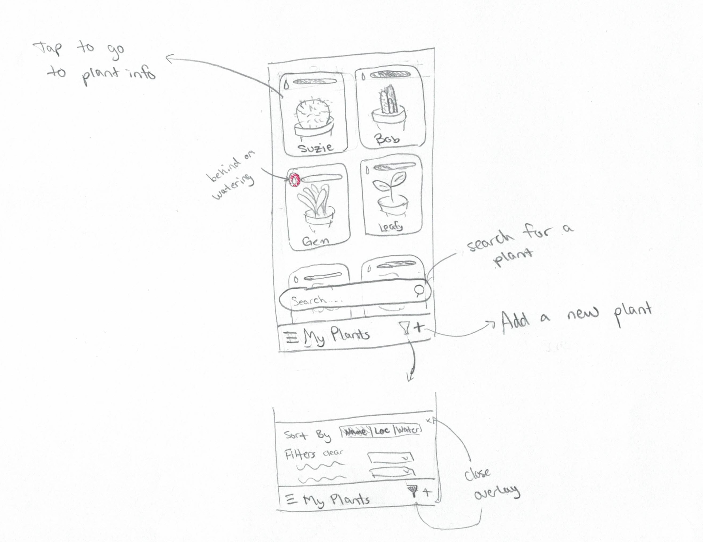
Refining the Project (paru)
Plant Information Screen
Narrowed down what information will be present on this screen
Decided on how this screen would be formatted, and where information would go
My Plant List / Home Screen
We had two list designs that we were debating on, eventually
decided on a layout like the following:
Notes:
Plant Information Screen
Narrowed down what information will be present on this screen
Decided on how this screen would be formatted, and where information would go
My Plant List / Home Screen
We had two list designs that we were debating on, eventually decided on a layout like the following:

Slide 8
Refining the Project (paru)
Navigation
Initially wanted to implement navigation bar
Chose to go with a menu for navigation to different features and screens
Recommended Plants
Initially located at the bottom of the catalogue
Now the recommended plants are shown at the opening of the home page
Notes:
Navigation
Initially wanted to implement navigation bar
Chose to go with a menu for navigation to different features and screens
Recommended Plants
Initially located at the bottom of the catalogue
Now the recommended plants are shown at the opening of the home page

Slide 9
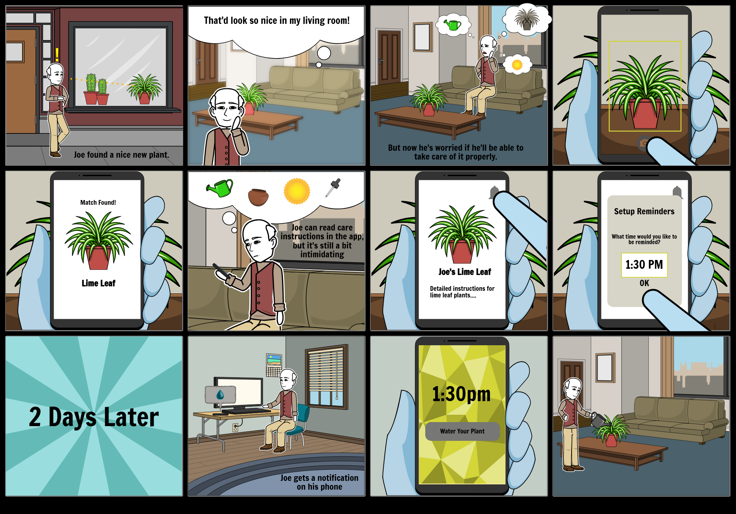
Storyboard
Notes:
Gabby

Slide 10
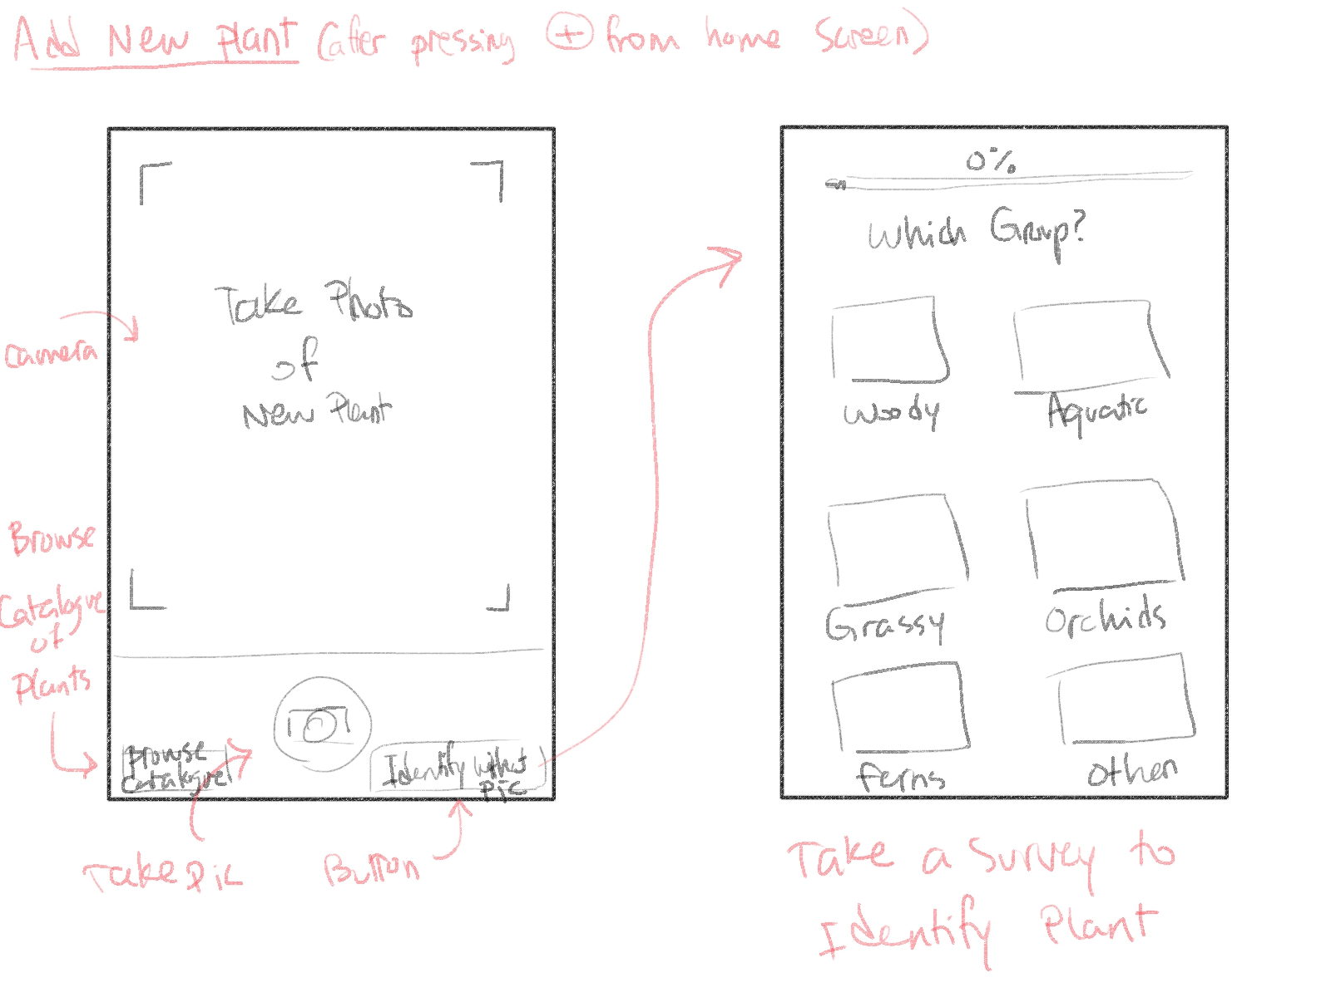
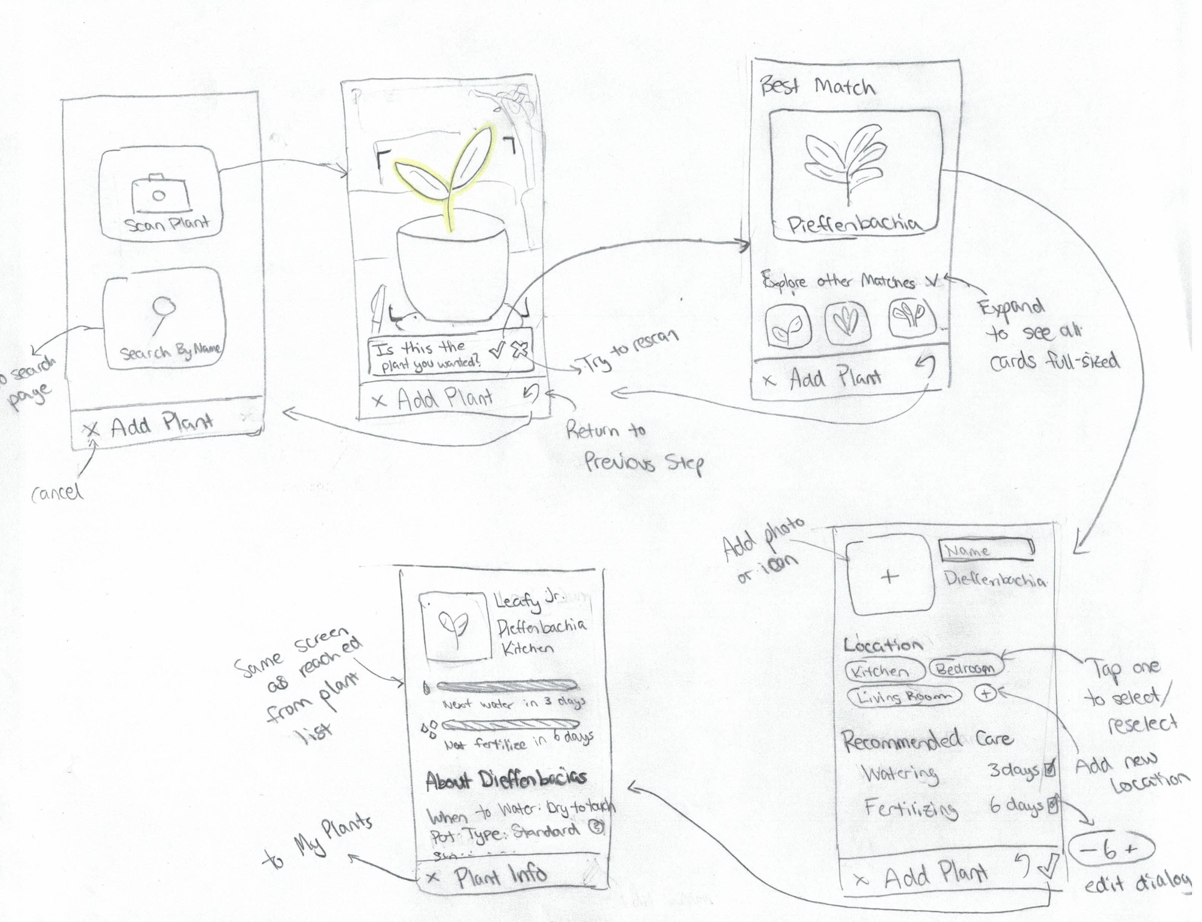
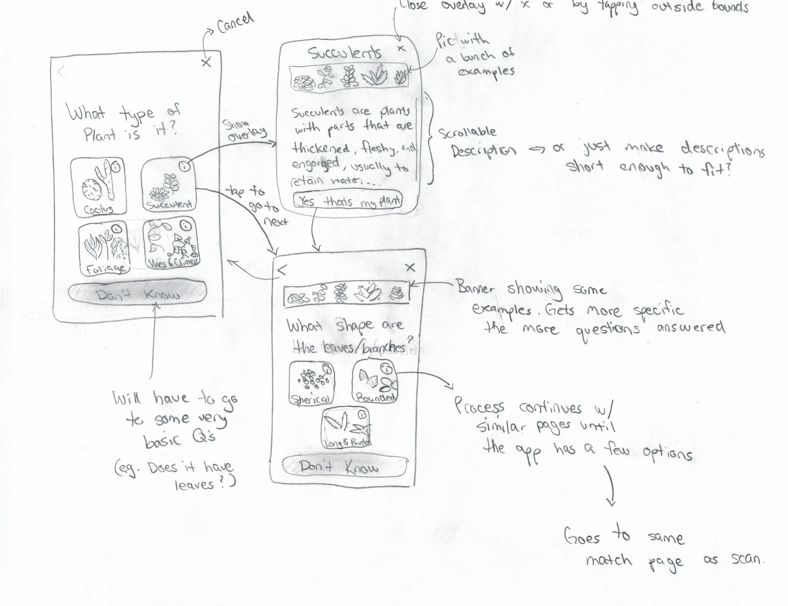
Lessons from Low-fi Designs
Scrollable interactions are hard to prototype
Quick to update/adjust
Helped solidify mental connections between pages
Helped to find UX flaws through interacting with low-fi prototype
Notes:
Gabby

Slide 11
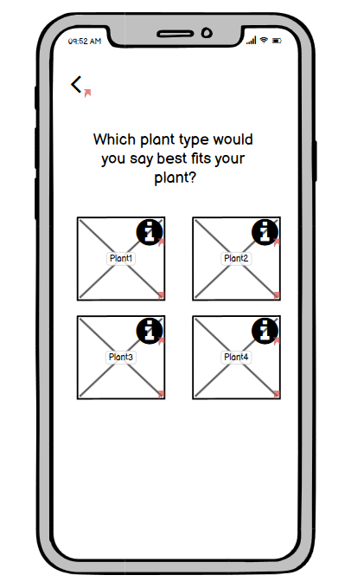
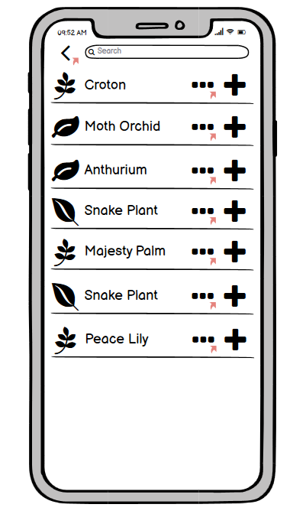
Cognitive Walkthrough
Conclusions:
Add optional guides for less intuitive features
Prioritize showcasing the major functions
Decrease ambiguity
Modifications:
Add back navigation
Add info boxes
Future Modifications:
Add User manual or guideline
Notes:
After conducting the cognitive walkthrough of the first version of our low-fidelity prototype, we concluded that we should add optional guides for the less intuitive portions of our app, prioritize showcasing the major functions over the more minor tasks, and decrease ambiguity as much as possible through proper design. Afterwards, we modified the prototype based on some of the suggestions. For example, we added back navigation to allow users to backtrack to the previous screen or added information boxes for the plant identification survey questions. Some of the other suggestions were difficult to implement in a low-fidelity prototype so they should instead be implemented in the high-fidelity prototype or the product itself. These modifications include adding a user manual or guideline on how to navigate within the app and further explain some of the functions.

Slide 12
Lessons we Learned
Flesh out the core features before moving on to the more optional and niche functions.
Through the process of refining our application, the result will change from what was originally envisioned.

